Slide 1
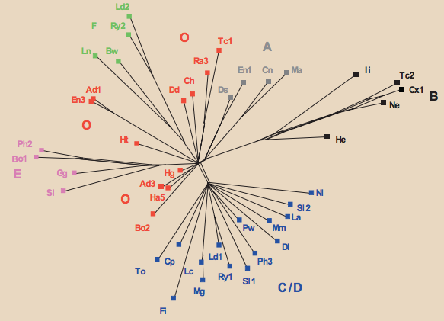
Cantenbury tales
Notes:
58 extant fifteenth-century manuscripts of “The Wife of Bath’s Prologue” 850
Laozi and Tao Te Ching

Slide 2
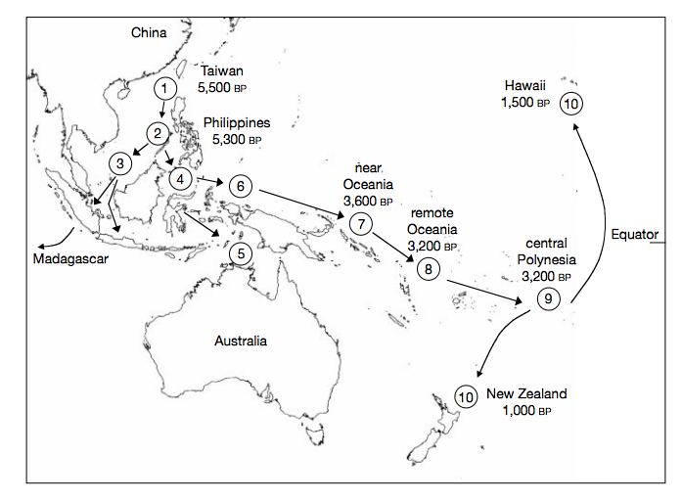
“Express train” model of Austronesian colonization

Slide 3
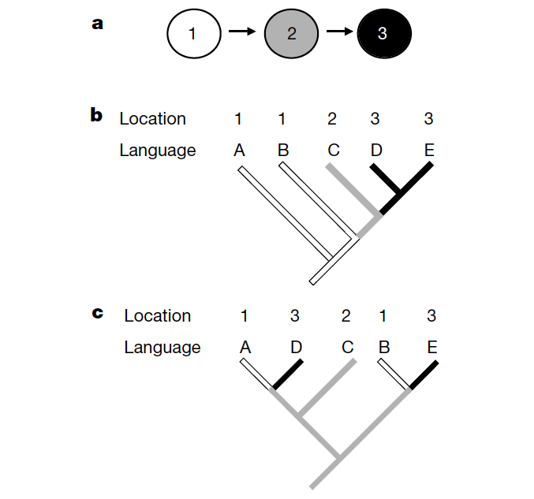

Slide 4
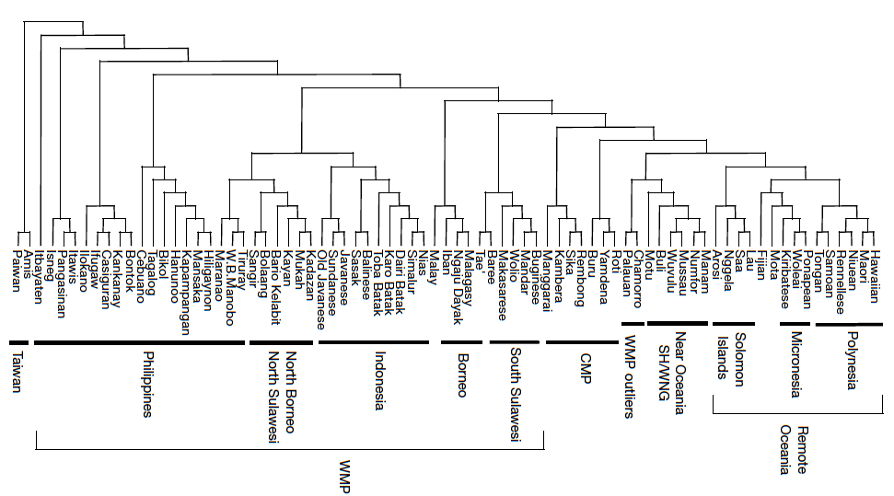

Slide 5
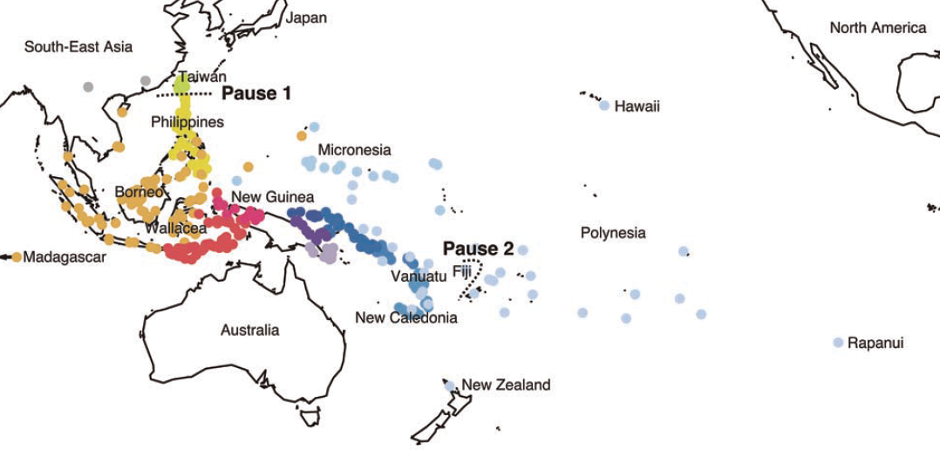
A more recent study

Slide 6
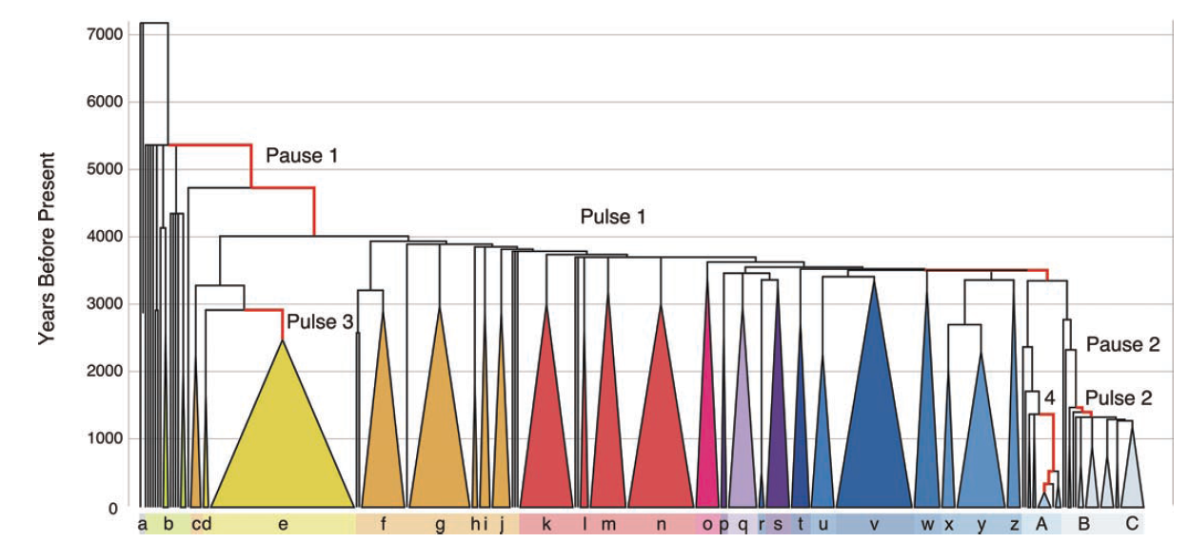
Pulses in expansion

Slide 7
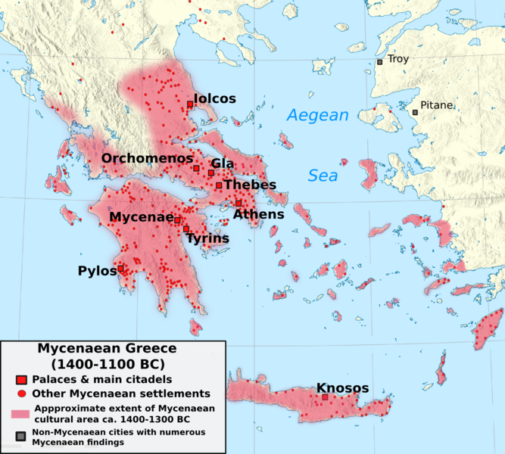
Evolution of the Mycean Greek script Linear B
Notes:
late Aegean Bronze Age between 1450 and 1200 BC

Slide 8
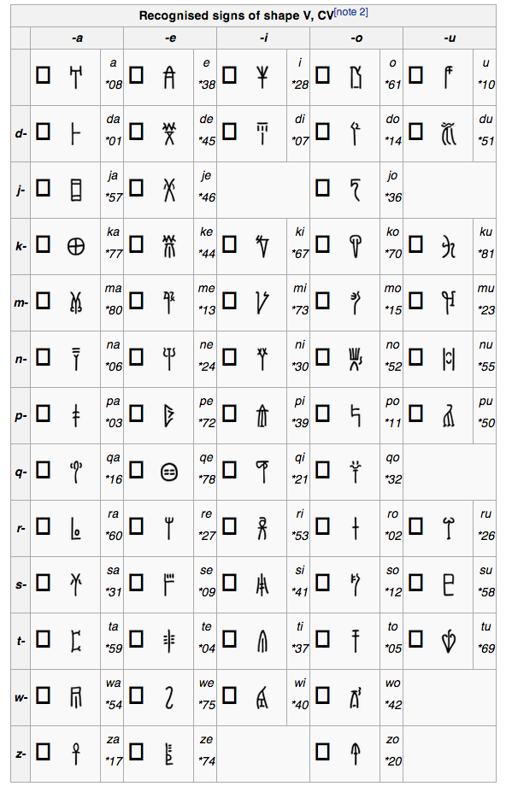

Slide 9
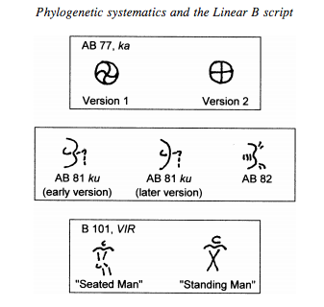

Slide 10
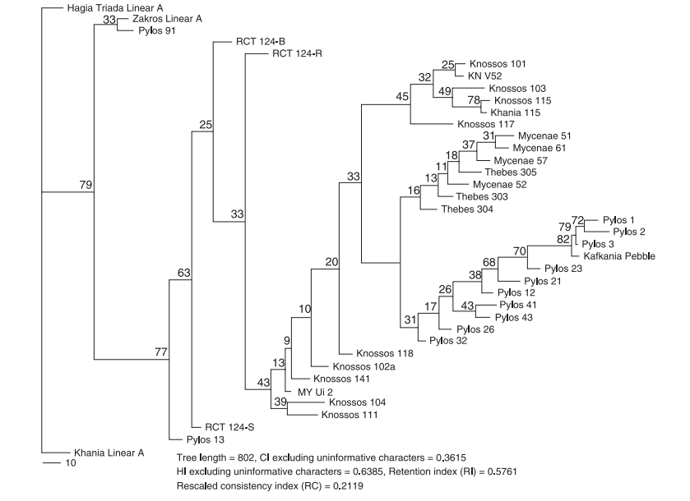

Slide 11
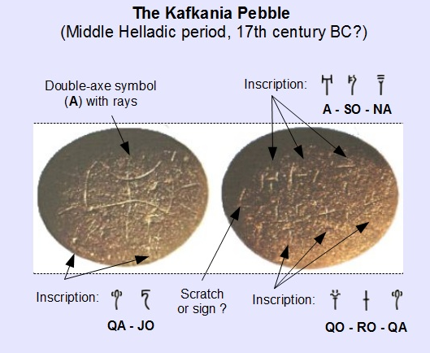

Slide 12
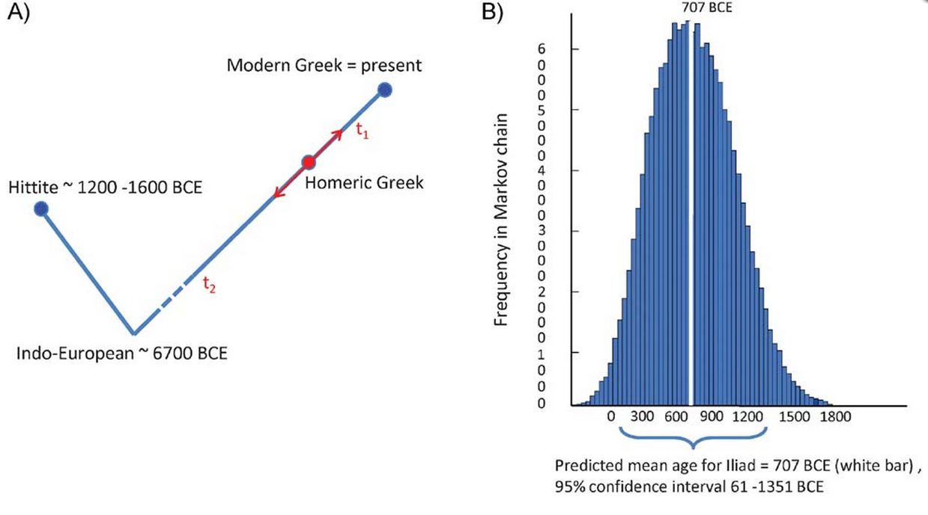
How old is the Illiad itself?

